Slide 1
Dawn Blossoms Plucked at Dusk
Final project - creating plugins for Napari
Junru Jin
2023.6.3

Slide 2
Outline
1. Build a pre-loading SVS Reader
2. Build an On-The-Fly SVS Reader (DASK)
3. Add On-The-Fly Image Processing to your lazy SVS Reader (HED)
4. Add On-The-Fly deep learning model to your lazy SVS Reader (MODEL)

Slide 3
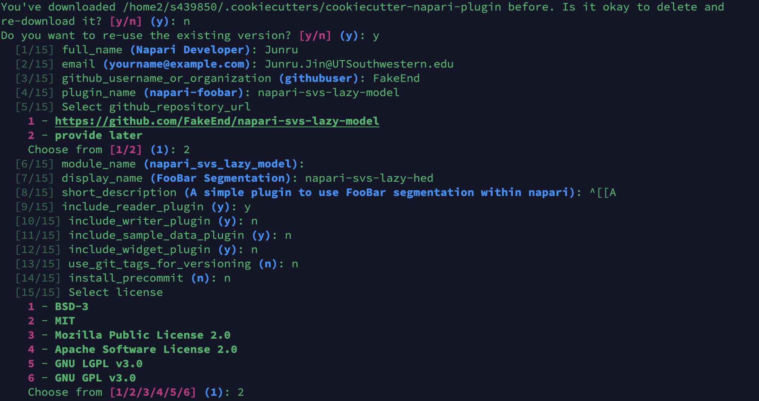
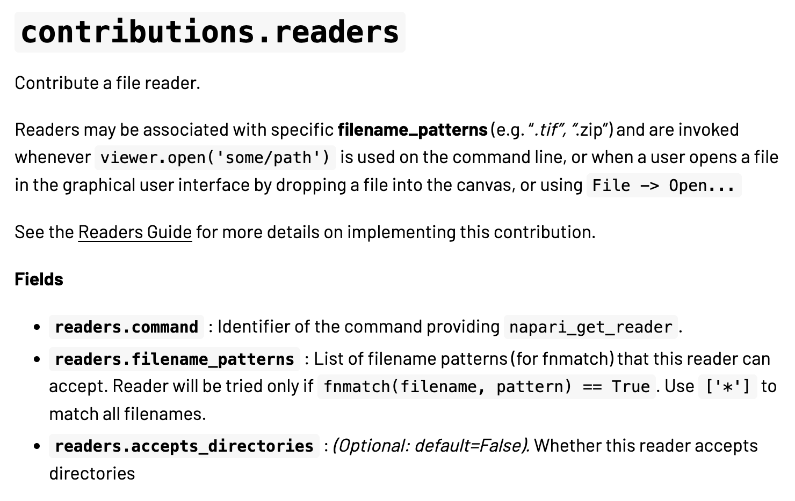
SVS Reader
First we use cookiecutter to create a template for every plugin
cookiecutter https://github.com/napari/cookiecutter-napari-plugin
Becasue we only need reader function. Here we just keep reader plugin

Slide 4
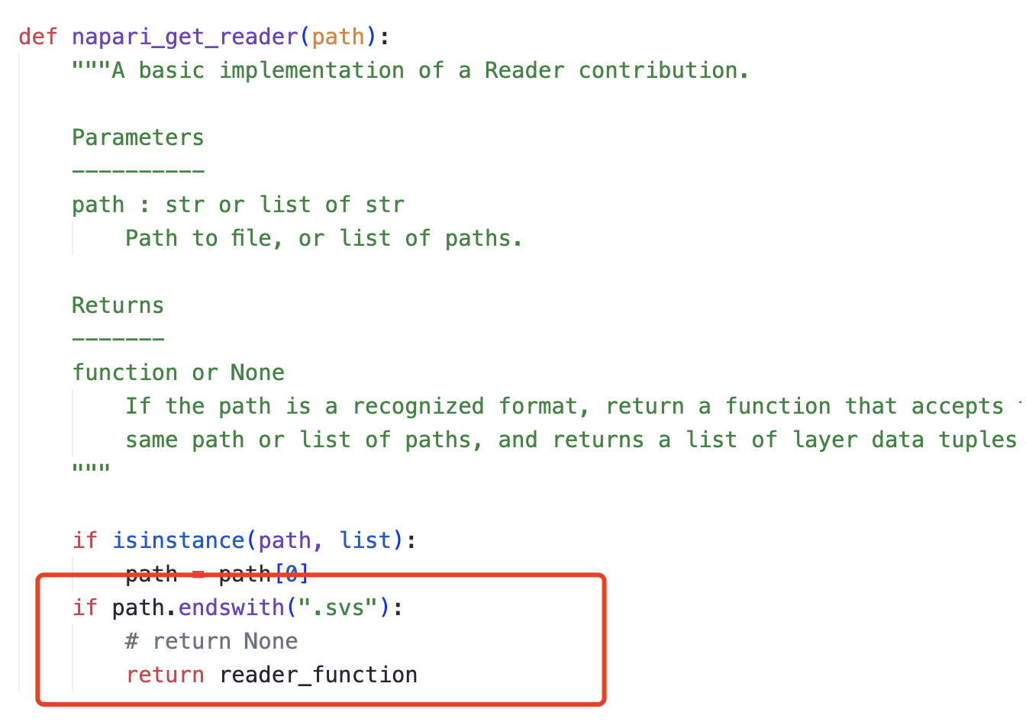
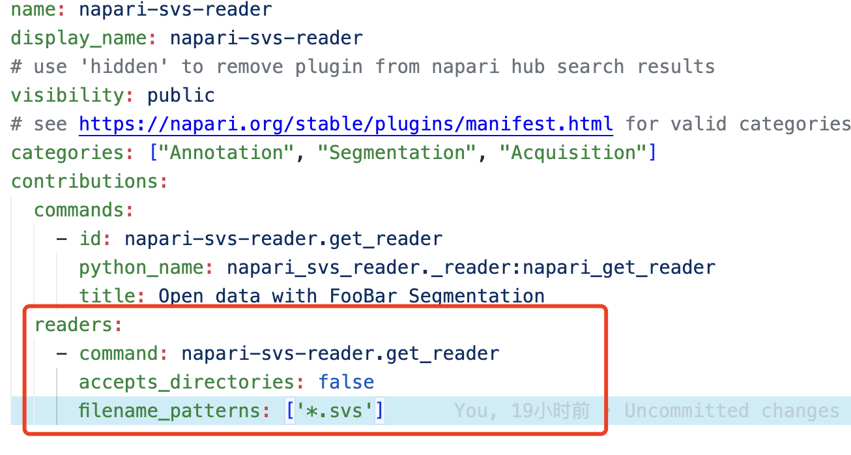
SVS Reader
To open a SVS Reader, we need to replace the file name with SVS

Slide 5
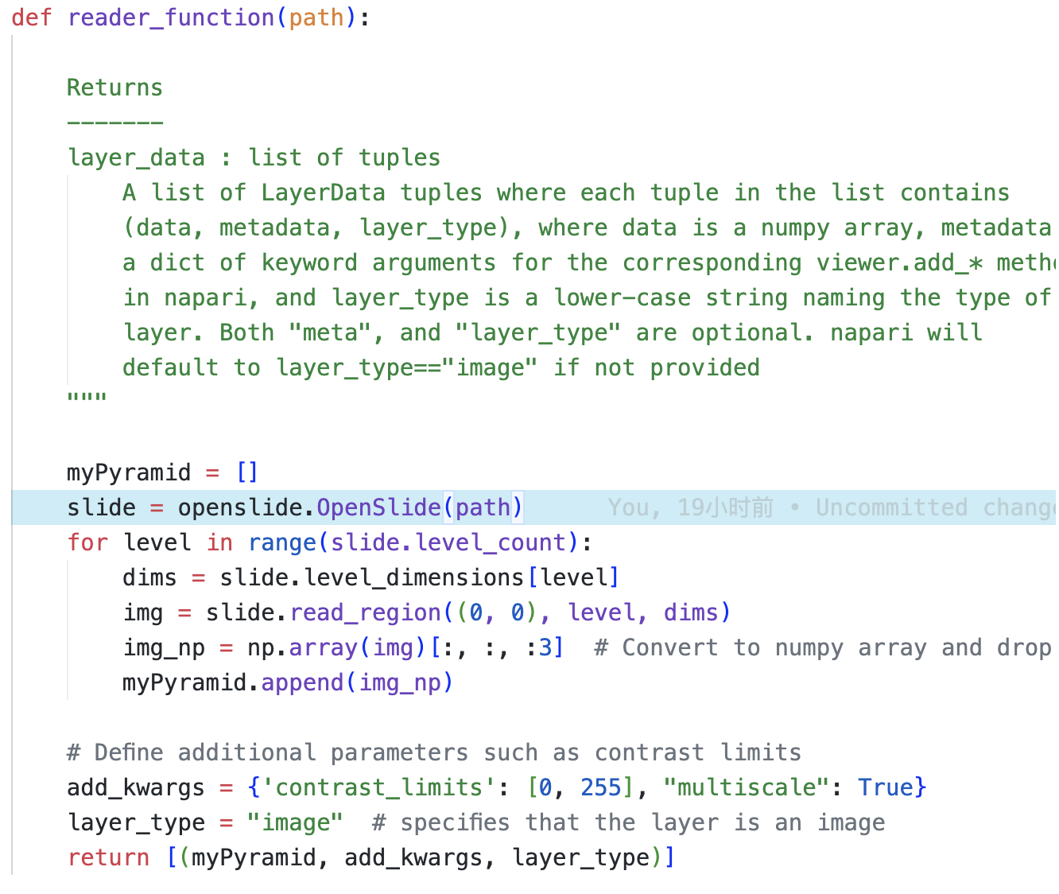
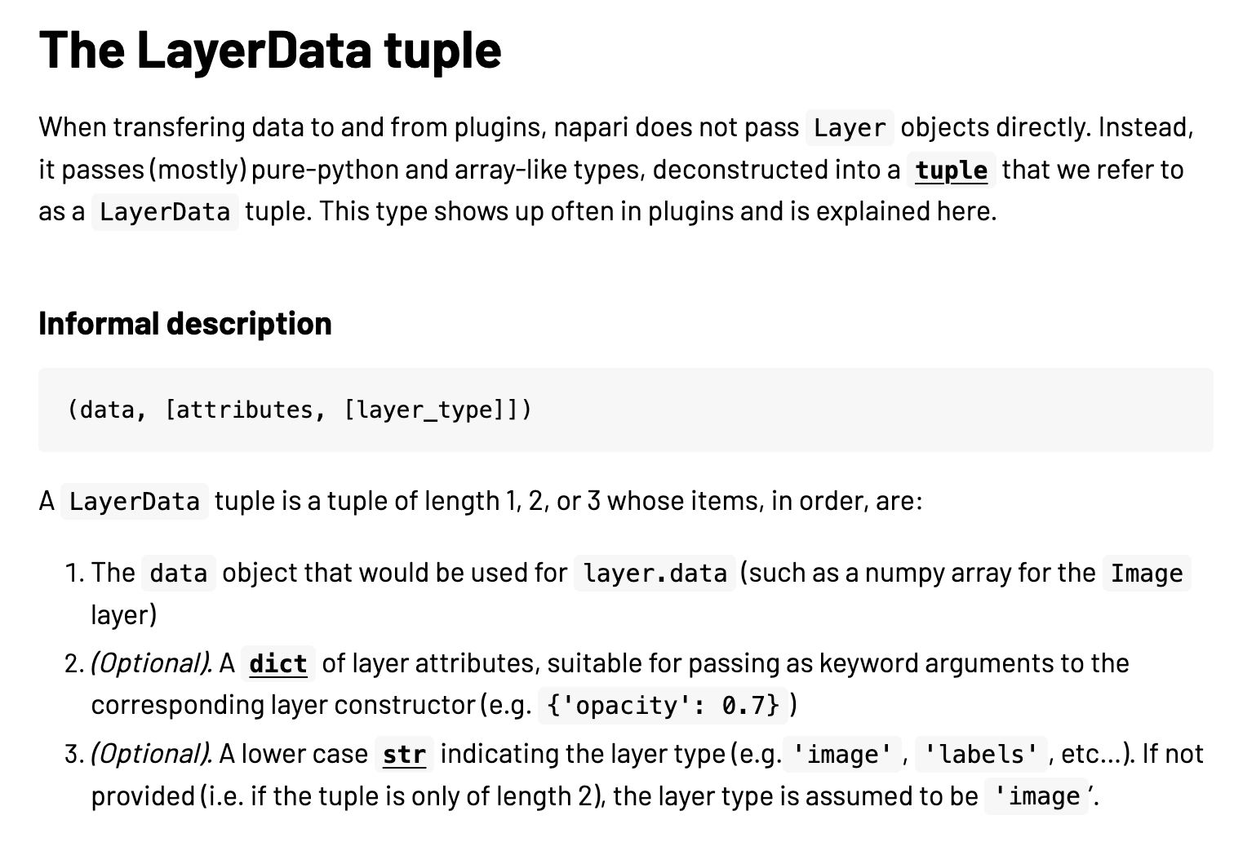
SVS Reader
Then we use openSlide to view svs file and add multi-scale as parameters when return array.
python -m pip install -e .

Slide 6
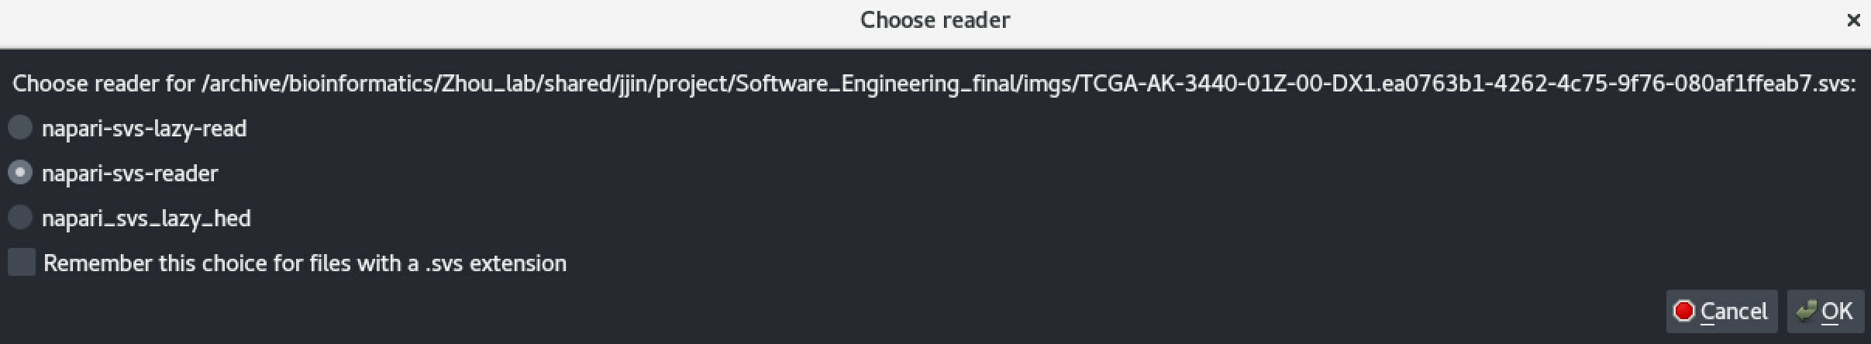
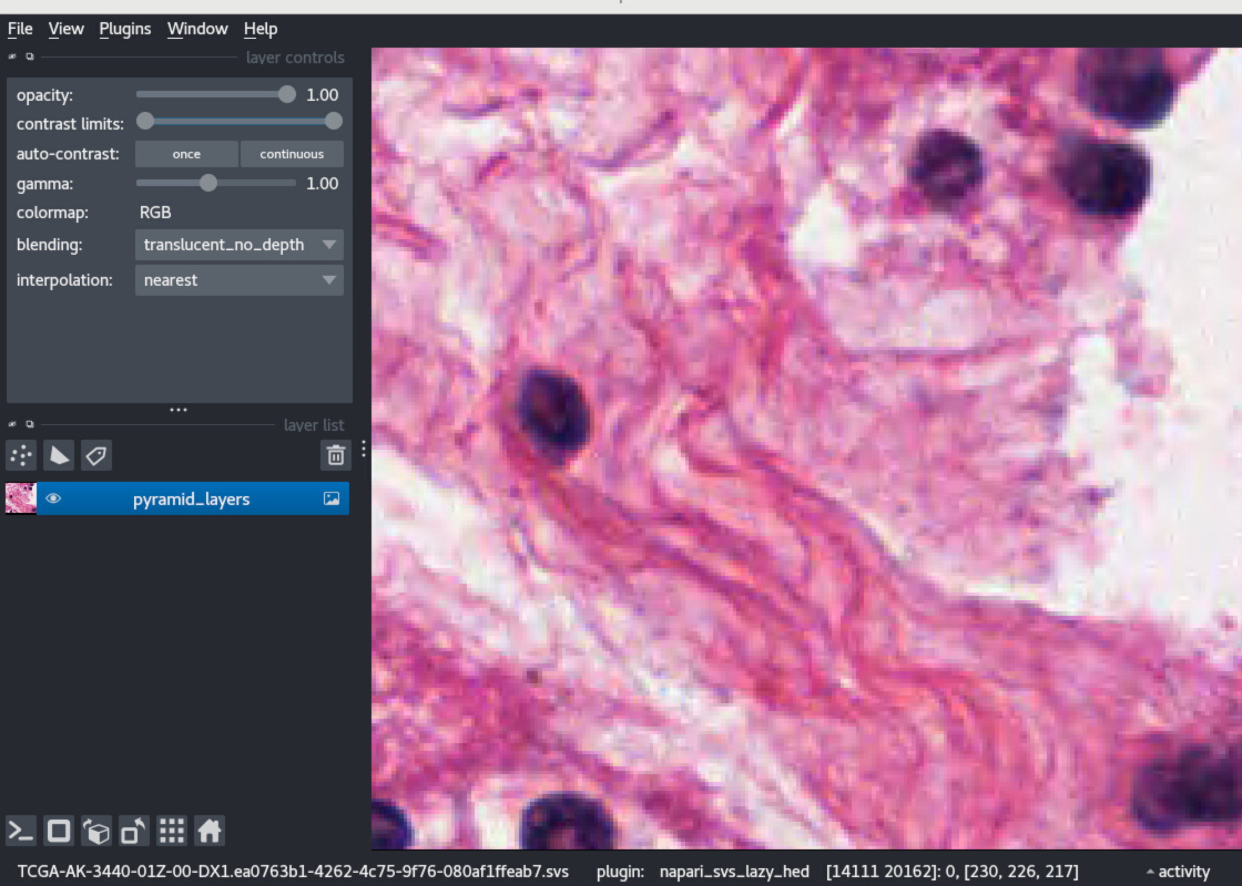
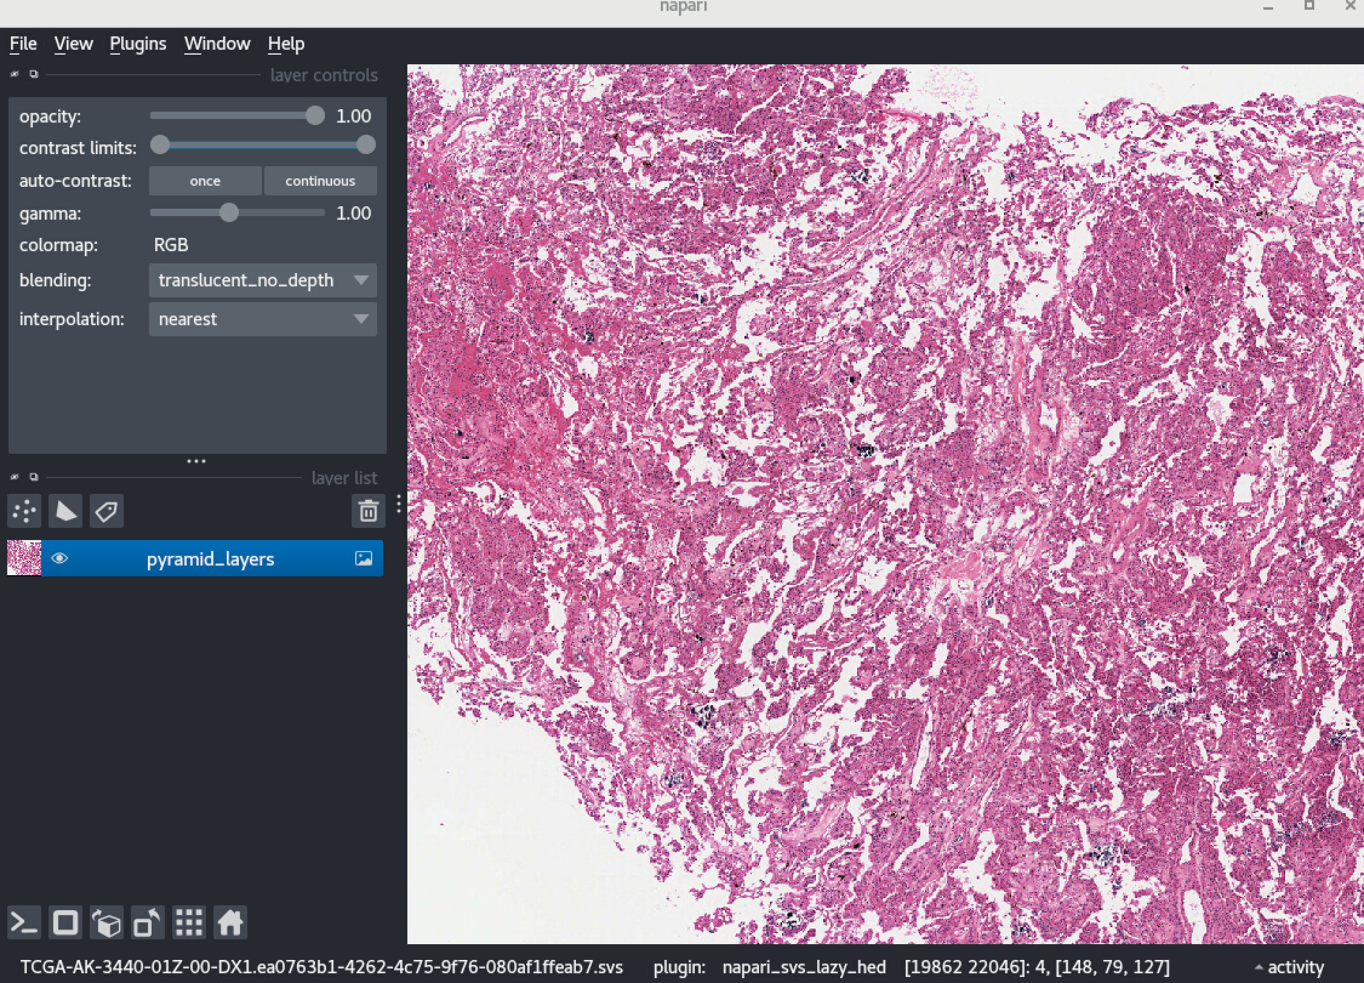
SVS Reader

Slide 7
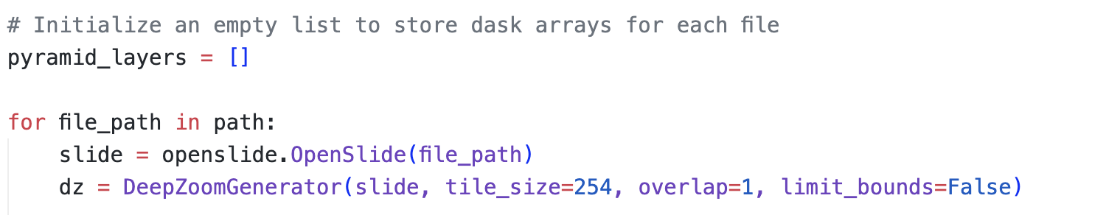
Lazy SVS Reader (DASK)
To speed up the SVS Reader, we take advantage of Dask's lazy (i.e., delayed) evaluation ability, which doesn't need to pre-load the whole image pyramid into memory, but instead reads the part of the image it needs to display on the fly.
1) OpenSlide's deep zoom functionality

Slide 8
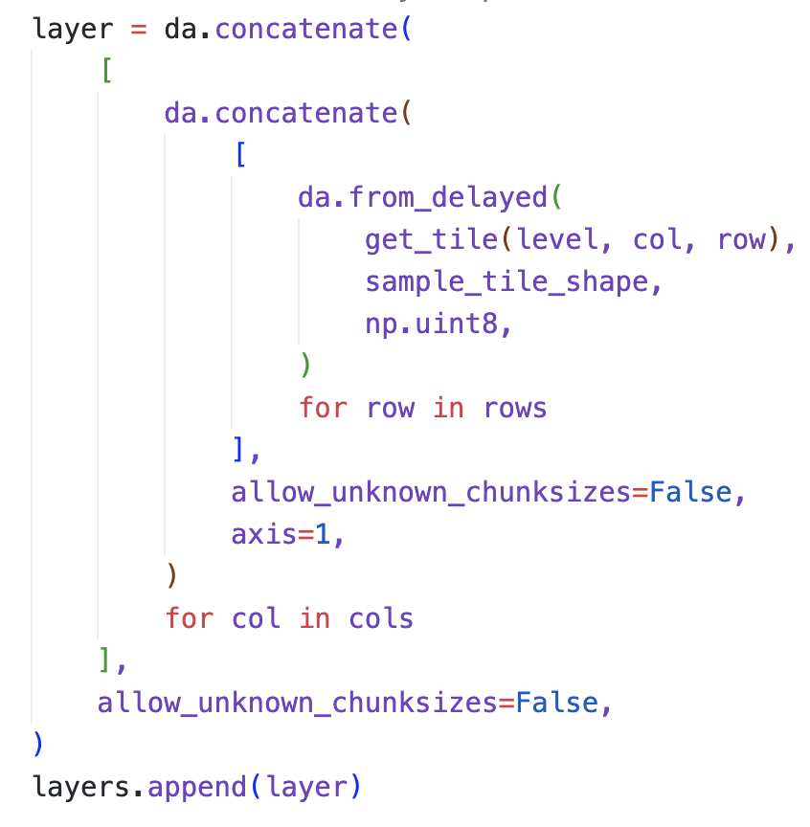
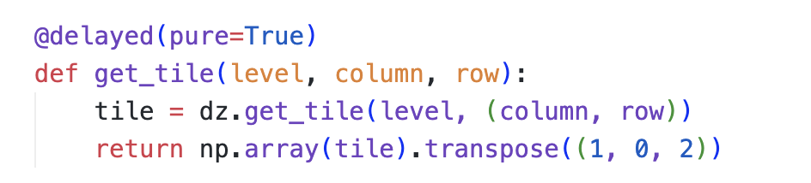
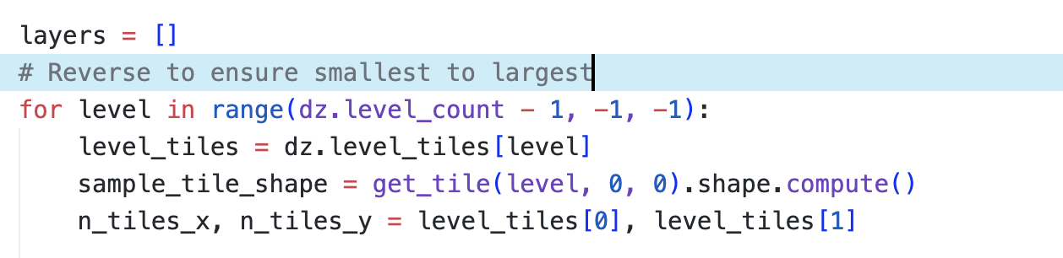
Lazy SVS Reader (DASK)
2) Use get_tile to load individual tiles
3) Write a loop over zoom levels and tiles within each level to load up the whole image. Now wrap this within the from_delayed functionality to enable lazy evaluation.

Slide 9
Lazy SVS Reader (DASK)
Much faster!
Load speed from 2 minutes to 20 seconds

Slide 10
Lazy SVS Reader (HED)
In this task, we need to use rgb2hed to identify nuclei when we are zoomed in enough.
rgb2hed is a function converting an RGB (Red, Green, Blue) image into a HED (Hematoxylin, Eosin, Diaminobenzidine) image, which is a color space commonly used in histology for staining images. The HED color space separates the stains commonly used in biological tissue staining:
Hematoxylin stains cell nuclei blue.
Eosin stains the extracellular matrix and cytoplasm pink.
Diaminobenzidine (DAB) is typically used to stain specific proteins brown in immunohistochemistry.

Slide 11
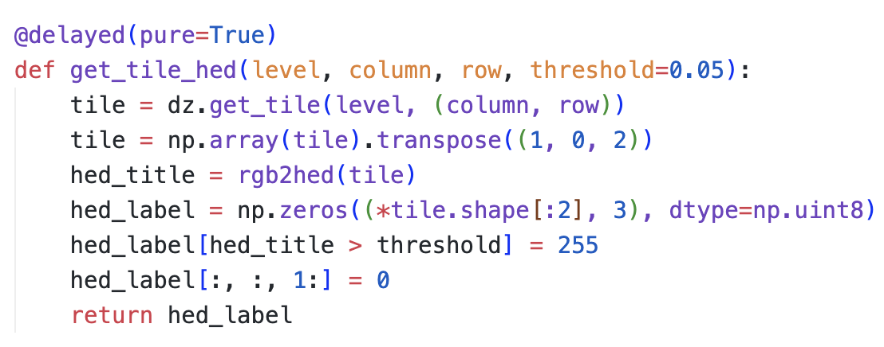
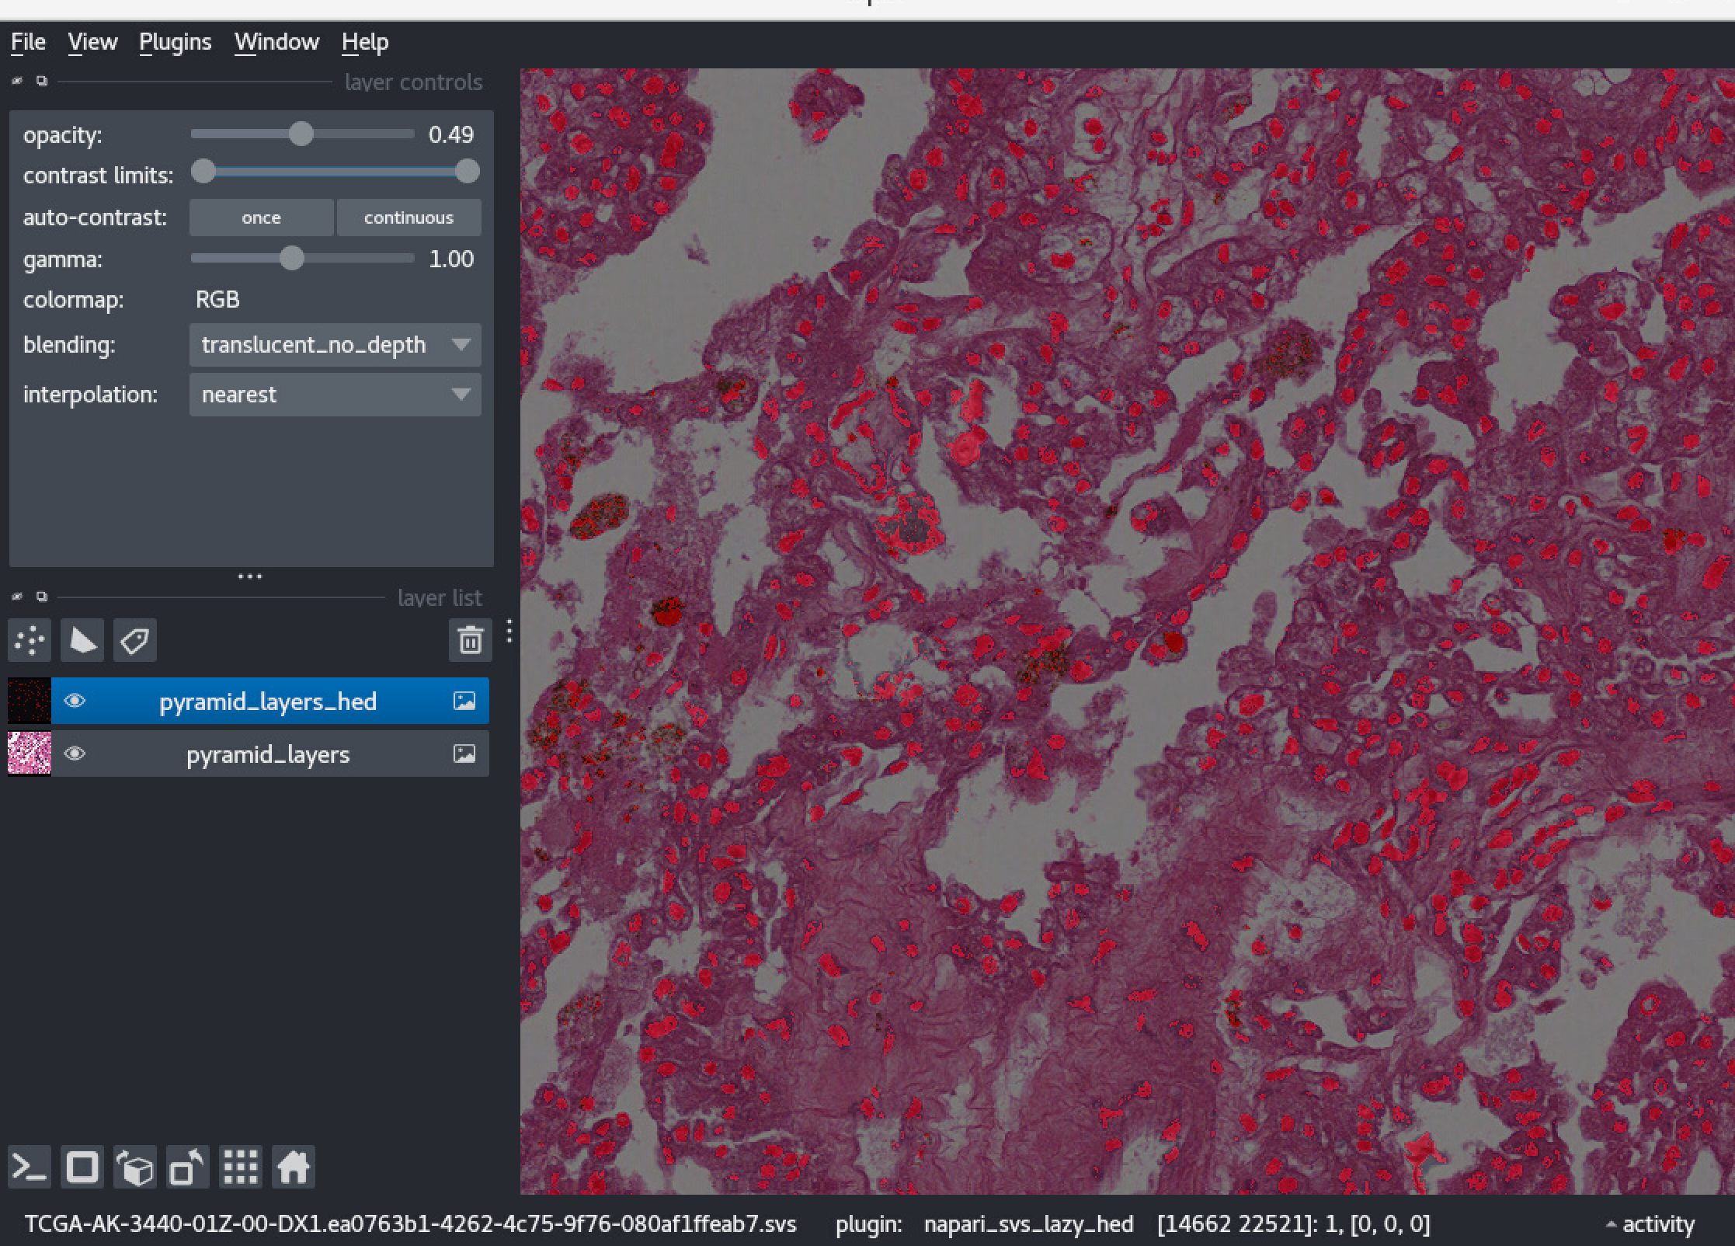
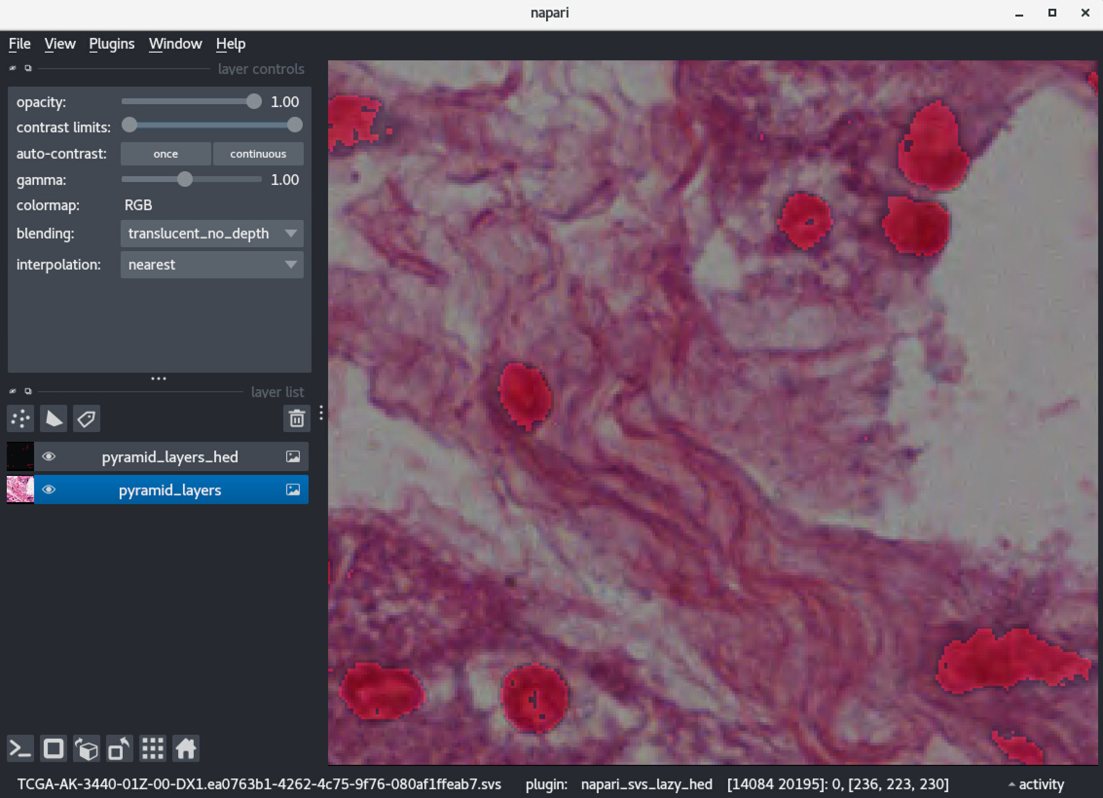
Lazy SVS Reader (HED)
1) Implement rgb2hed function
2) Return 1 if it is above a certain threshold (for simplicity you may hardcode this value) and zero otherwise.

Slide 12
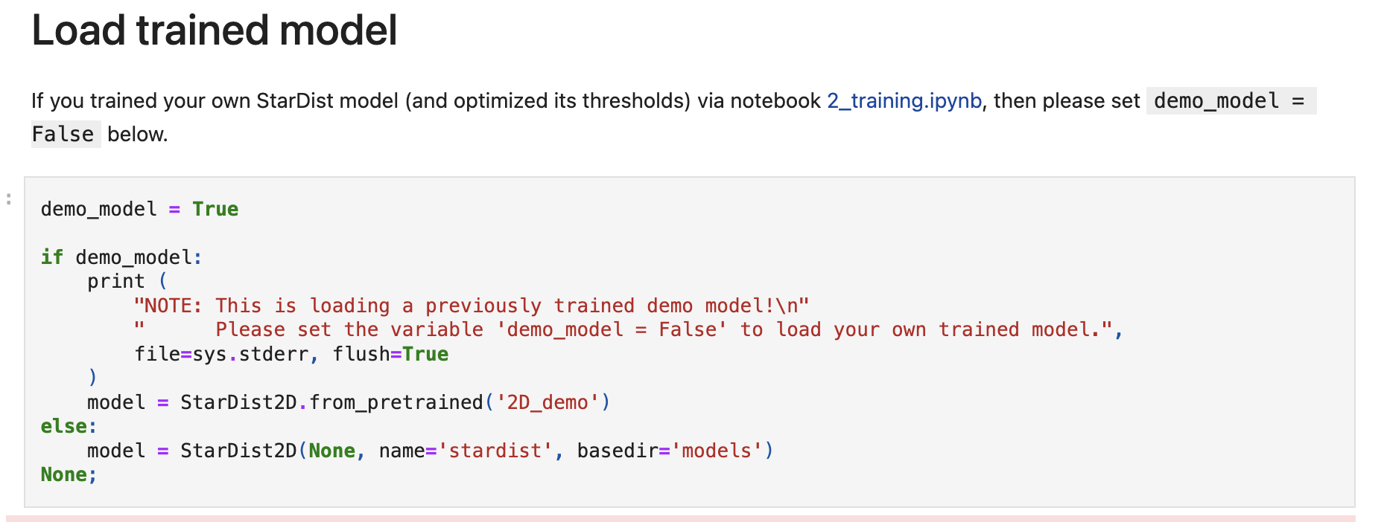
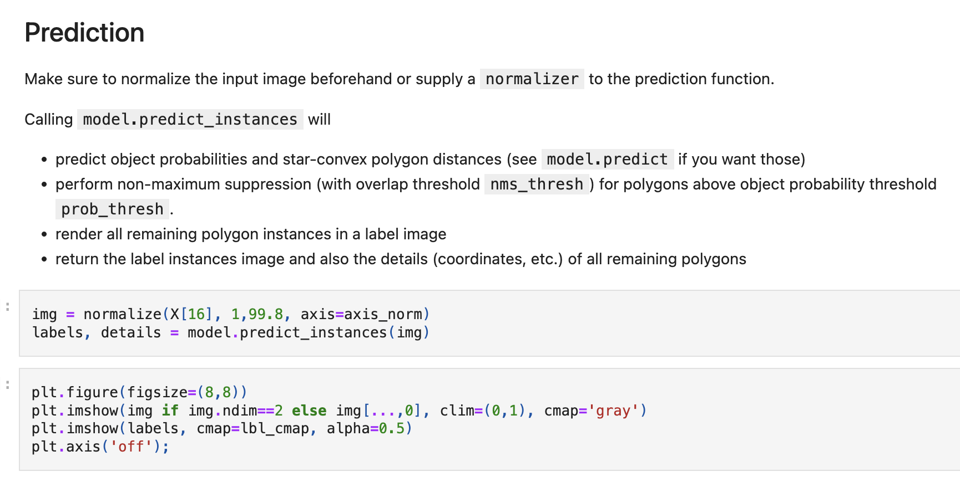
Lazy SVS Reader (Model)
In this project, we use 2D_versatile_he to do nuclei segmentation.

Slide 13
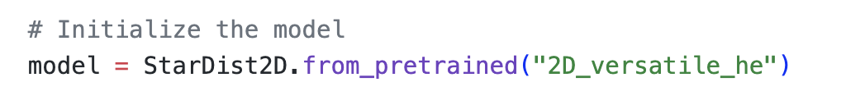
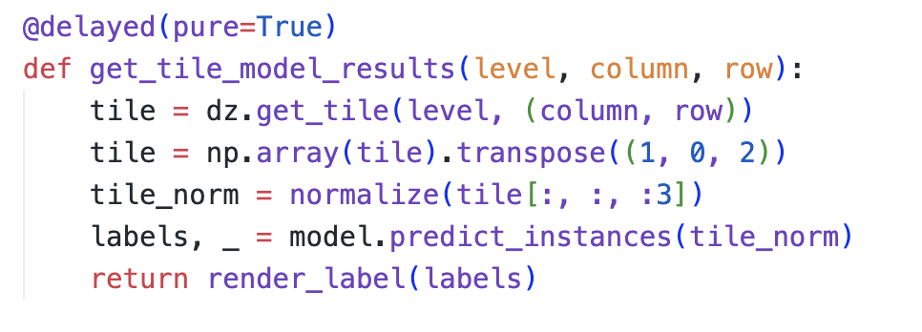
Lazy SVS Reader (Model)
Here we do same thing as demo:
Initialize model
normaize model
predict results
render results

Slide 14
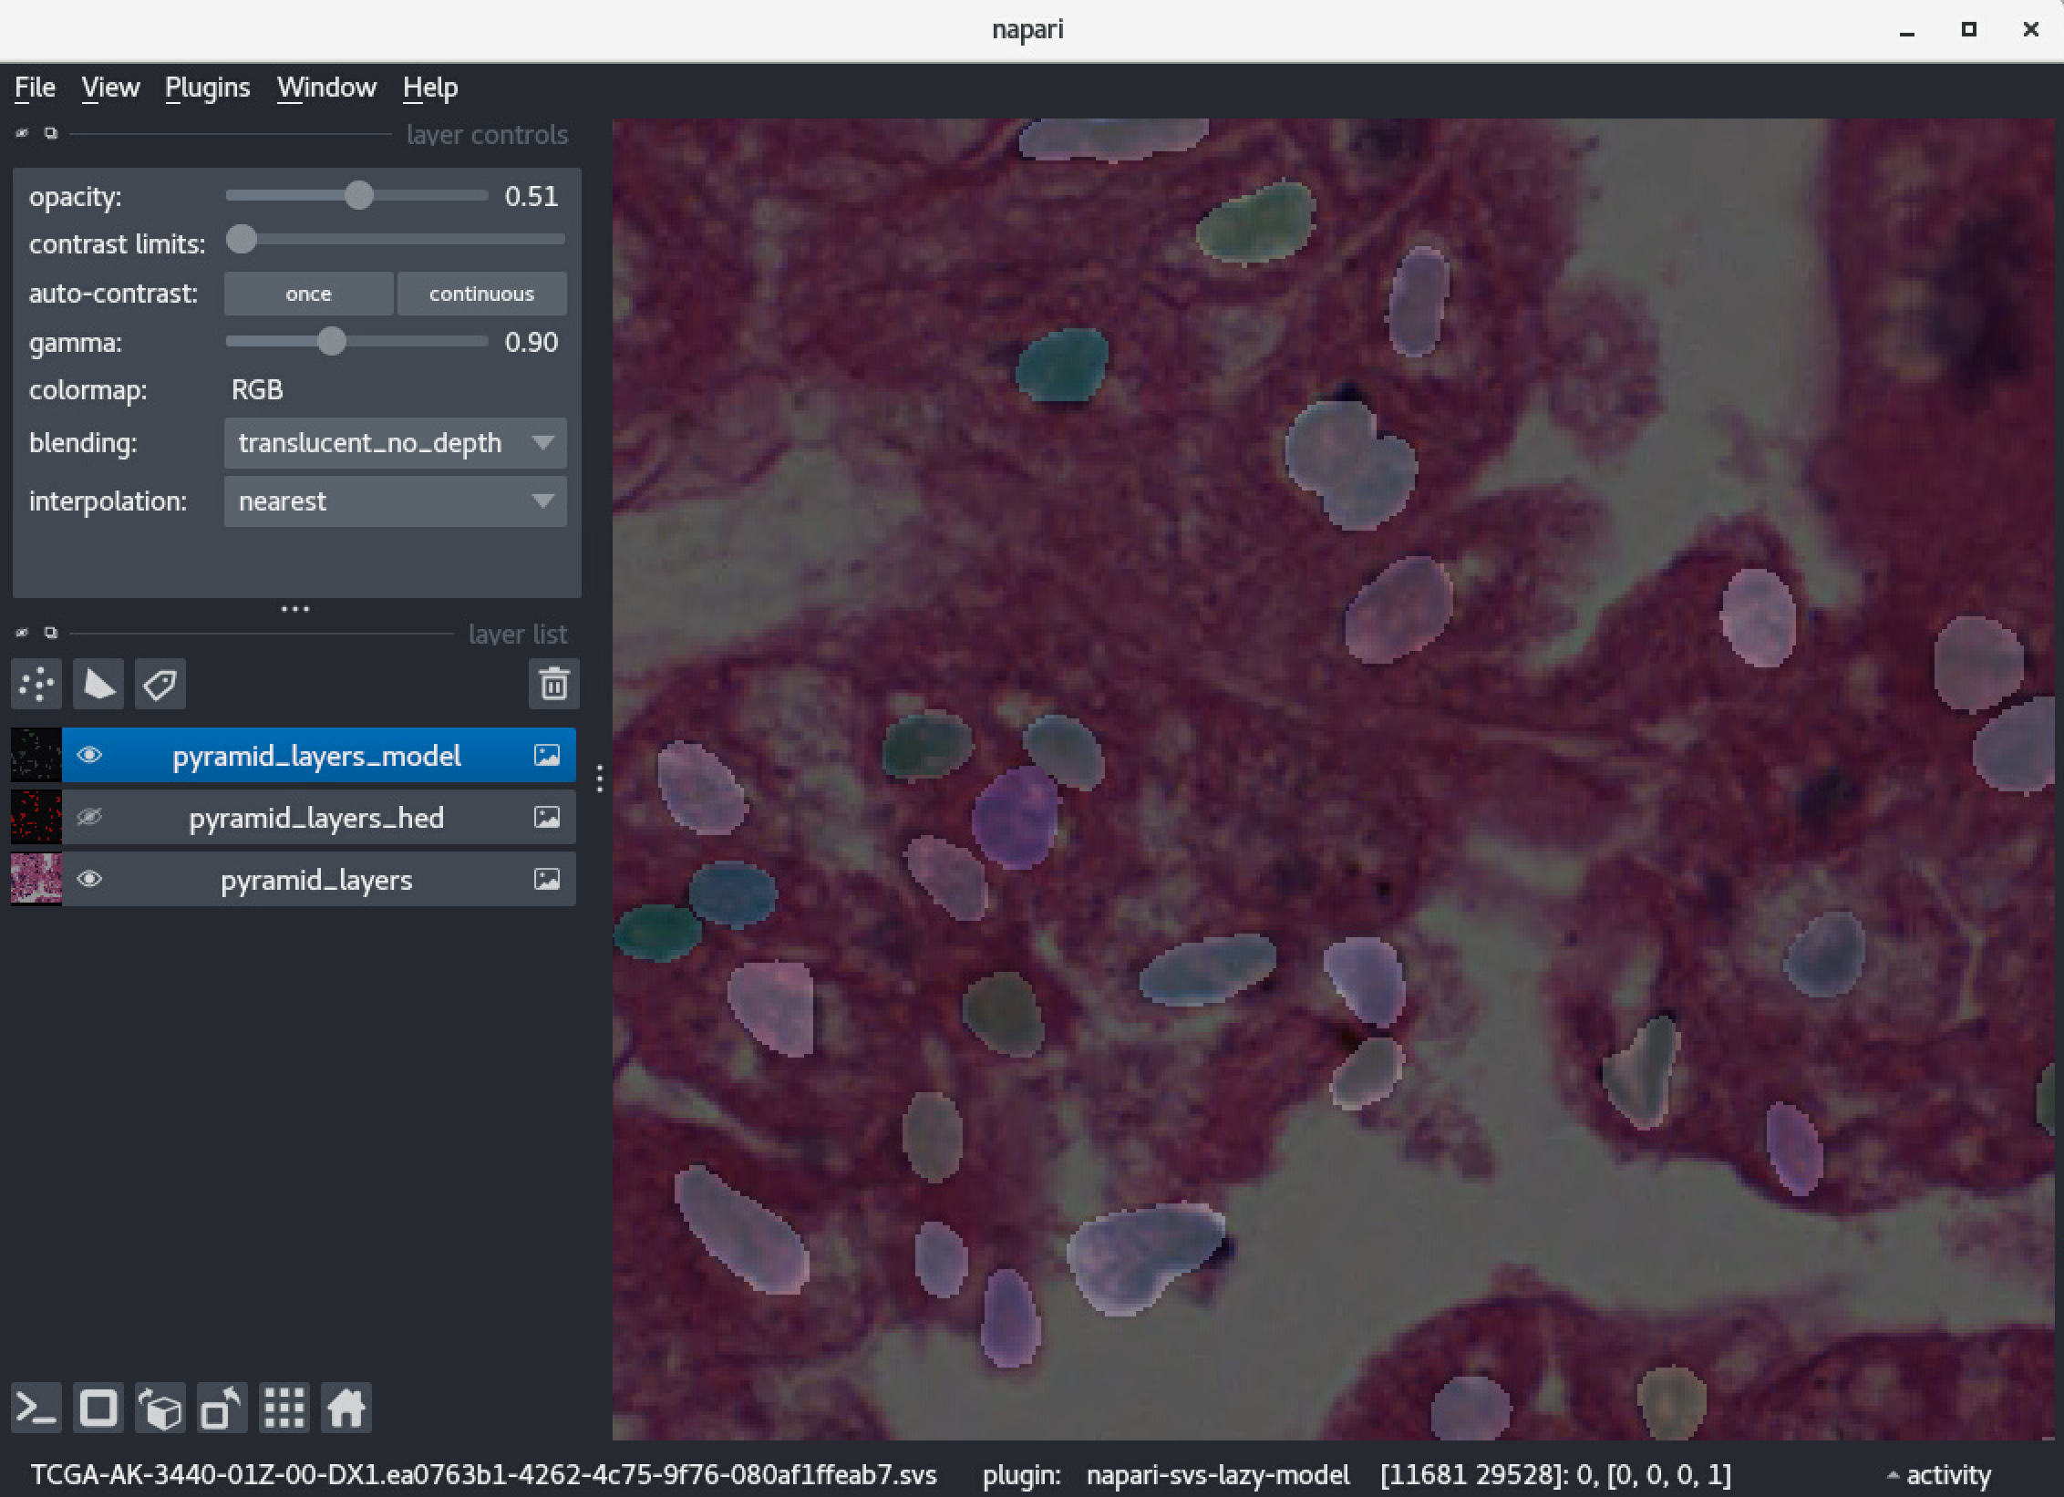
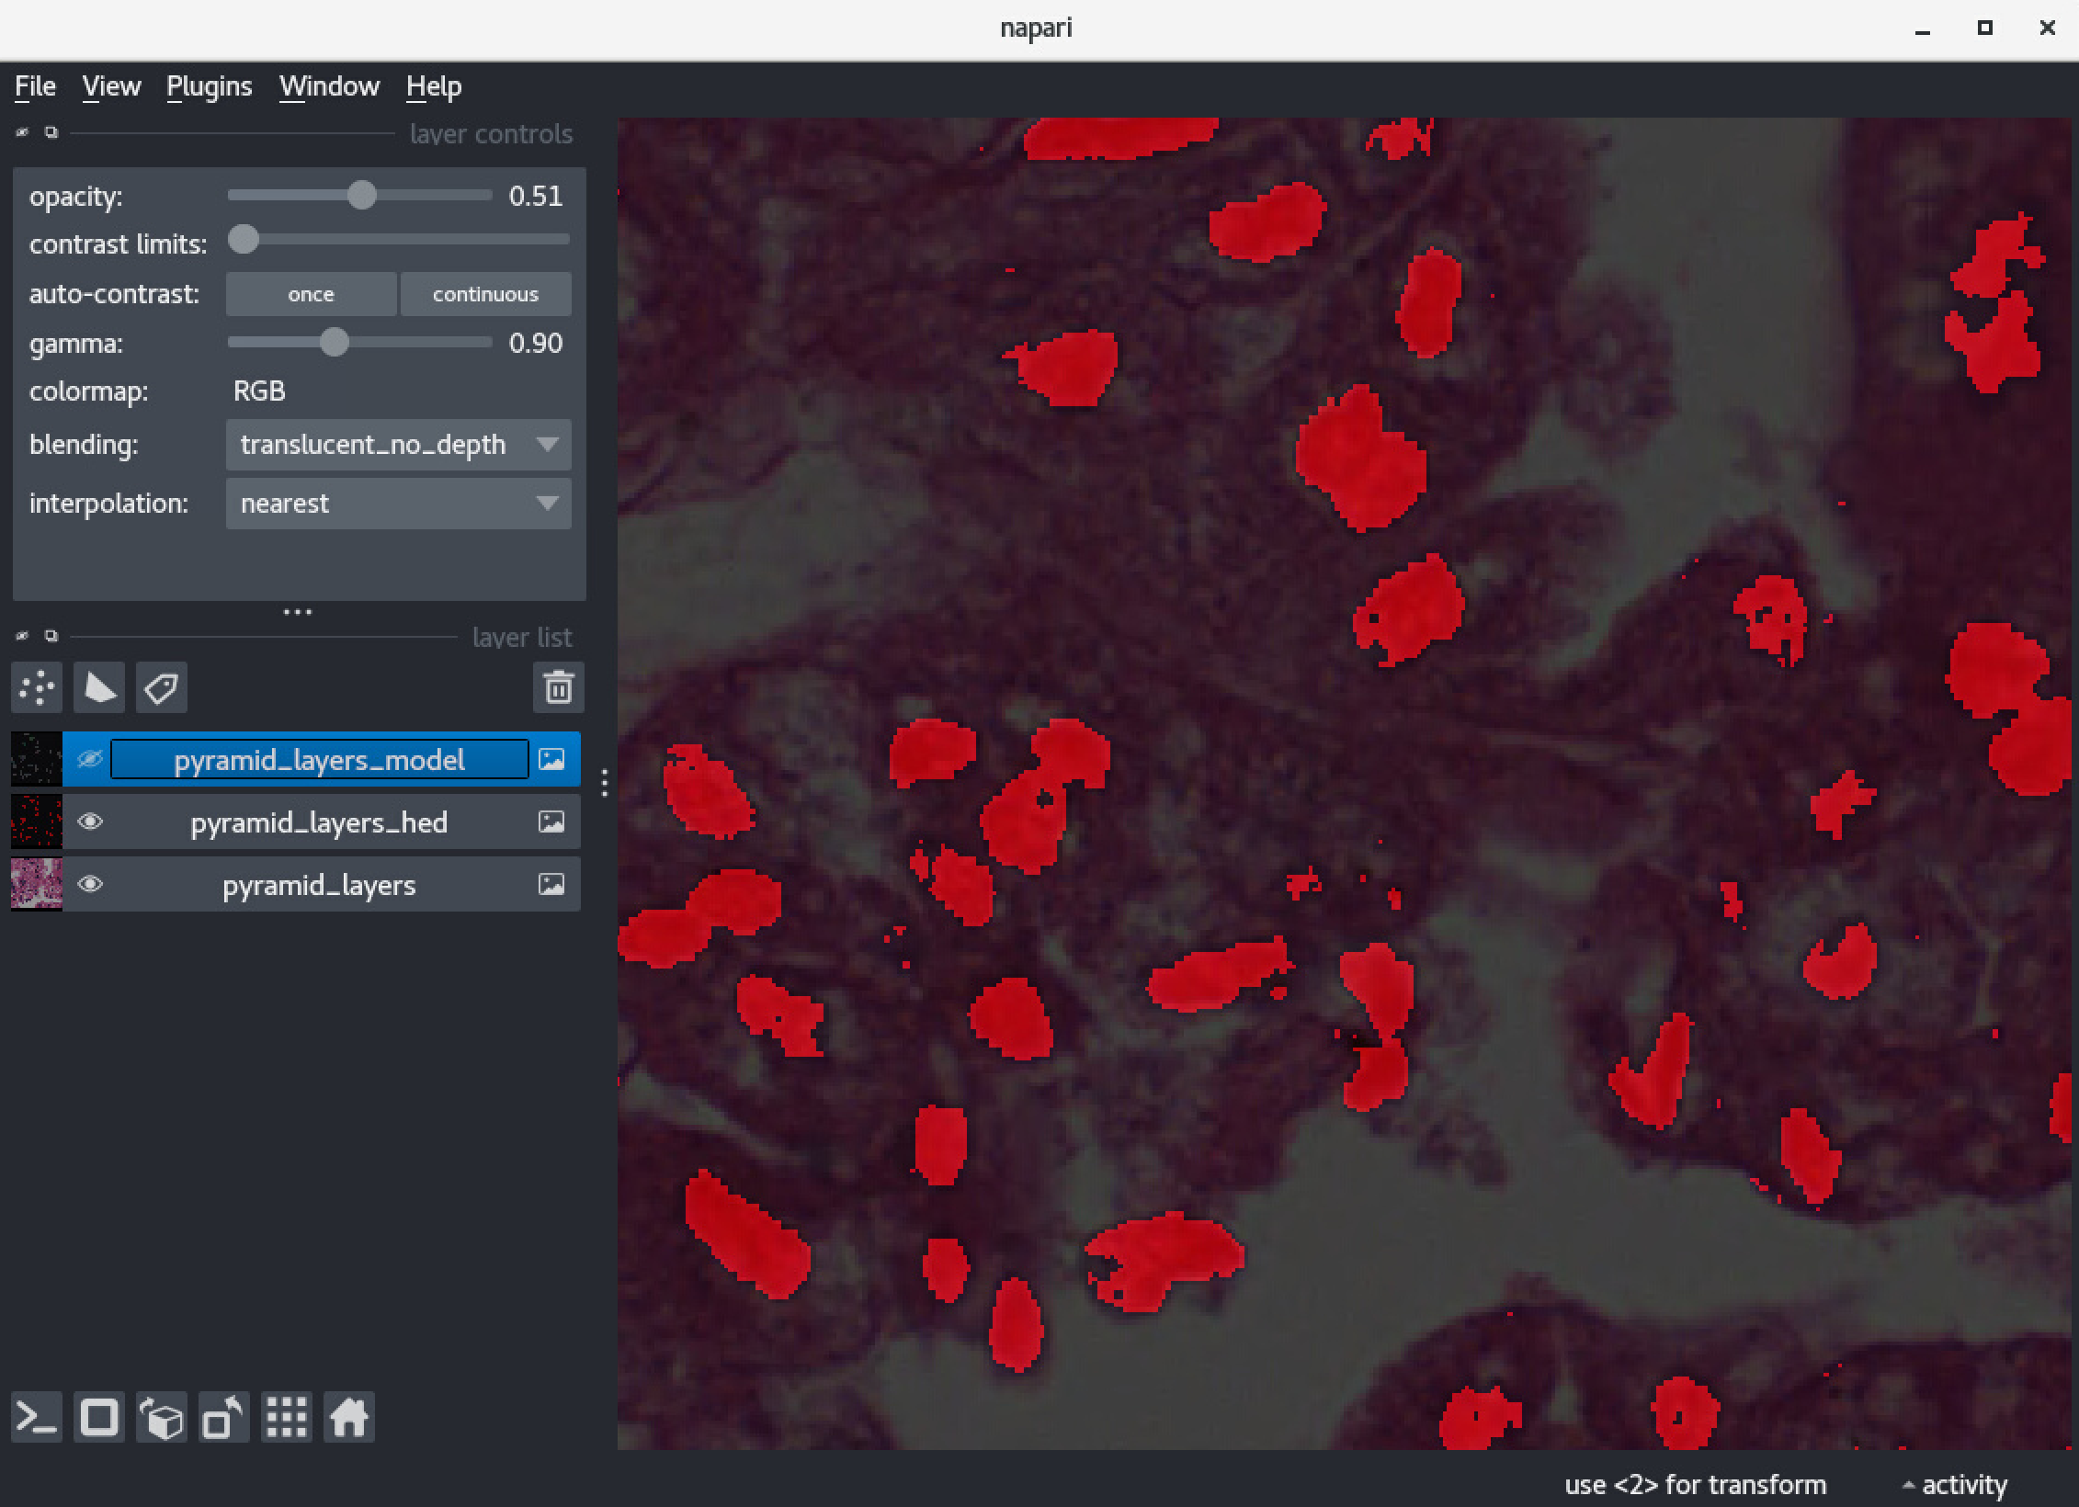
Lazy SVS Reader (Model)
Model prediction
Labels

Slide 15
Thanks for listening

